Slide 1
PRINCIPLES OF ECONOMICS
Salimah Musharrif
FPEC 101 – LECTURE 13 Unit 2

Slide 2
PRINCIPLES OF ECONOMICS
Production Costs and Market Structures
FPEC 101 – LECTURE 13 Unit 2

Slide 3
Wage determination

Slide 4
Outline
Key concepts
Labor Productivity
Wage Differentials
Minimum Wage Rate
Pay for Performance

Slide 5
Wage Determination
Wages are the price that employers pay for labor
Monetary and non monetary
Hourly wage rate is the price paid per unit of labor services, in an hour of work.
Labor earnings is the wage rate multiplied by the number of hours worked
Nominal wage or money wage is the amount of money received per hour, day, or year.
Real wage is the quantity of goods and services a worker can obtain with nominal wages; real wages reveal the “purchasing power” of nominal wages, adjusted for inflation or price rise
Derived demand – depends on Productivity of labor and Price of the good it helps to produce
In the long run, if productivity is increased substantially causing demand for labor to increase more rapidly than increase in the supply of labor S, it results in increased real wages.

Slide 6
Labor productivity
Higher the productivity of labor, higher the demand for it.
If the total supply of labor is fixed, then the stronger the demand for labor, the higher is the average level of real wages
Factors affecting Labor Productivity
  Capital availability
  Access to abundant natural resources
  Advanced technology More capital, and more advanced capital. Better work methods
  Labor quality The health, vigor, education, and training
  Other factors
  (a) the efficiency and flexibility of management
  (b) a business, social, and political environment that emphasizes production and productivity
  (c) the vast size of the domestic market, which enables firms to engage in mass production (d) the increased specialization of production enabled by free-trade agreements with other nations.

Slide 7
Purely competitive labor market
Numerous firms compete with one another in hiring a specific type of labor.
Each of many qualified workers with identical skills supplies that type of labor.
Individual firms and individual workers are “wage takers,” since neither can exert any control over the market wage rate.
Depends on
  Market Demand for Labor
  Market Supply of Labor

Slide 8
Purely competitive labor market
Market Demand for Labor
Labor Demand curves are called the MRP, the marginal revenue product curves
Downward sloping, higher the wage rate, lower the demand for labor
In the theory of competitive labor markets, the demand curve for labor comes from the estimated marginal revenue product of labor (MRPL)
It is defined as the extra revenue generated by a firm when it employs an additional unit of labor
MRPL = Marginal product of labor x marginal revenue
Marginal Revenue Product for Labor = Change in total revenue
Unit change in factor quantity

Slide 9
The Demand for Labour
Marginal
product,
MP
Marginal
revenue
product, MRP
Units of
a factor
Total
product
Product
price
Total
revenue
0
1
2
3
4
5
6
7
0
7
13
18
22
25
27
28
]
$2
2
2
2
2
2
2
2
$ 0
14
26
36
44
50
54
56
]
12
12
10
8
6
4
2
7
6
5
4
3
2
1
$ 14
]
]
]
]
]
]
]
]
]
]
]
MRPL = Marginal product of labor x marginal revenue
Marginal Revenue Product for Labor = Change in total revenue
Unit change in factor quantity

Slide 10
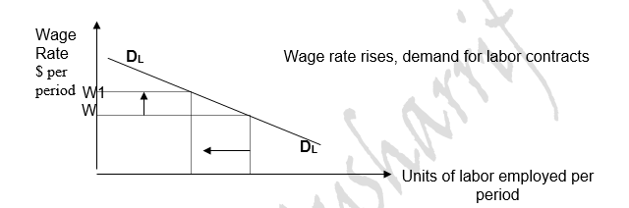
Purely competitive labor market
Market Demand for Labor

Slide 11
Purely competitive labor market
Market Demand for Labor
The changing patterns of demand of Labor
A change in the demand for a product
Mass production
Division of labor to achieve economies of scale
Worker productivity
Changes in the price and productivity of capital
Wages in other employment costs such as insurance, taxes etc

Slide 12
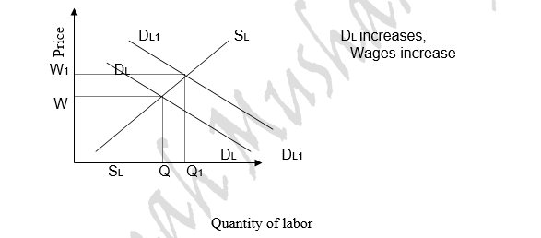
Purely competitive labor market
Market Demand for Labor

Slide 13
Purely competitive labor market
Market Supply of Labor
Upward sloping, higher the wage rate, higher the supply of labor
Higher wage rates are paid to attract workers away from alternative job opportunities available to them.
Also to induce people who are not currently in the labor force to seek employment

Slide 14
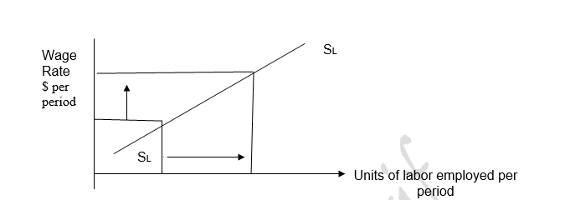
Purely competitive labor market
Market Supply of Labor

Slide 15
Purely competitive labor market
Market Supply of Labor
The changing patterns of supply of labor
Population
Net migration
It is less if the job requires special training, skills
The nature of the job
Work environment
Timings of work
Education and training
The number of people going into a certain profession
The barriers to the entry in an occupation
Wages in substitute occupation
non wage factors or fringe benefits are also known as net advantages

Slide 16
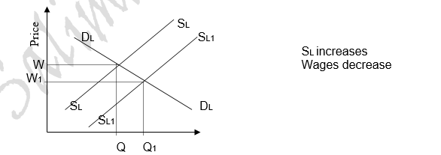
Purely competitive labor market
Market Supply of Labor

Slide 17
Purely competitive labor market
Equilibrium
Profit maximizing level of employment
Firm considers
  The Marginal revenue product for Labor
  Marginal resource Cost or cost of employment
Firm should employ labor up to the point where the
Marginal Revenue Product of Labor = Marginal Cost of labor
The cost of hiring an additional worker equals to the extra sales revenue from selling their output

Slide 18
Purely competitive labor market
Equilibrium
Each of the many firms employs such a small fraction of the total available supply of this type of labor that none of them can influence the wage rate. The supply of this labor is perfectly elastic to the individual firm, as shown by horizontal line
When the price of a resource is imposed on the individual competitive firm, the marginal cost of that resource (MRC) is constant and is equal to the resource price. Here, MRC is constant and is equal to the wage rate. Each additional worker hired adds precisely his or her own wage rate to the firm’s total resource cost. So the firm in a purely competitive labor market maximizes its profit by hiring workers to the point at which its wage rate equals MRP or MRC = MRP

Slide 19
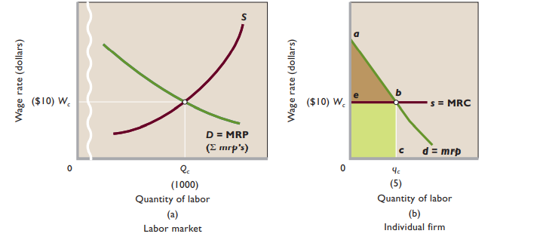
Purely competitive labor market
Equilibrium for market and firm (profit maximizing level)
The equilibrium wage rate Wc and
the number of workers Qc in (b )are determined by labor S and D. (a)
Because this market wage rate is
given to the individual firm hiring in this market, its labor supply curves MRC is perfectly elastic.
Its labor demand curve, d, is its MRP curve
Firm maximizes its profit by hiring workers up to MRP = MRC.
Area 0abc represents both the firm’s
total revenue and its total cost.
The green area is its total wage cost
The brown area is its nonlabor costs,
including a normal profit— that is, the firm’s payments to the suppliers of land, capital, and entrepreneurship.
Normal profit earned by firm
TR-Wage cost
Total wage cost
Mc Connell & Brue

Slide 20
Purely competitive labor market
Elasticity of Market Demand for Labor
Responsiveness of labor demand due to a change in the wage rate
Depends on
  Labor cost as percentage of total costs
  Ease and cost of factor substitution
  Price elasticity of demand for final output

Slide 21
Purely competitive labor market
Elasticity of Market Supply for Labor
Responsiveness of labor supply due to a change in the wage rate
Depends on
  Availability of Good Substitutes to specific labor
  Specific skills and educational requirements
  Time period
    Short run, inelastic as it takes time for people to respond to changes in relative wages.

Slide 22
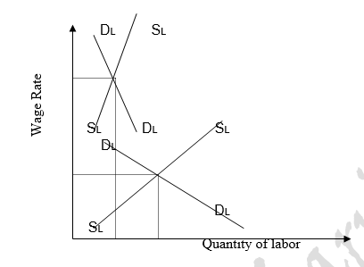
Purely competitive labor market
For skilled labor, demand and supply is relatively inelastic; therefore, there is a higher wage lesser supply of labor available.
For unskilled workers, the demand and supply for labor is elastic because there are fewer skills required and more labor supply of the available

Slide 23
Wage Differentials
Differences in wages between different occupations
Position in an occupation
Qualifications and experience
Education
Racial or gender discrimination
Skills
Nature of the job …risky or timings
Whether it’s in the private sector or public sector
Employer discrimination
Trade Unions

Slide 24
Wage Differentials
Differences in wages between different occupations
Immobility
Satisfaction
Efficiency and hard work
Profession you are involved in, example lawyers and doctors get high pay
The reputation of the institute one has studied from
Currency differences
Non monetary fringe benefits
The mobility of workers… if this is low, to increase mobility benefits such as housing Etc. may be given to encourage workers to change their profession.

Slide 25
Minimum Wage Rate
A “wage floor” that will help less skilled workers earn enough income to escape poverty.
Impact
  - Rising costs of production
  -May lead to decrease in workers hired
  -Poorly targeted to reduce poverty
  +Job losses may not occur in markets with short labor supply and great labor demand
  +May increase labor supply
  +Increases labor productivity
Conclusion
  More workers are helped by the minimum wage than are hurt
  Gives society some assurance that employers are not “taking undue advantage” of vulnerable, low-skilled worker

Slide 26
Pay for performance
  Piece Rates- compensation paid according to the number of units of output a worker produce
  Commissions -Employees who sell products or services
  Royalties -certain percentage of sales revenues from their works
  Bonuses- payments in addition to one’s annual salary
  Stock options- buy shares of their employer’s stock at a fixed, lower price when the stock price rises
  Profit Sharing- allocate a percentage of a firm’s profit to its employees.
  Efficiency Wages- above-equilibrium wage

Slide 27
SUMMARY
Nominal vs real wage
Role of Productivity
Purely competitive labor market
  Demand
  Supply
  Profit maximizing equilibrium
Wage Differentials
Minimum Wage Rate
Pay for Performance

